Slide 1
Employee Data Analysis using Excel
STUDENT NAME: KEERTHANA K
REGISTER NO:312208396
DEPARTMENT:B.COM(ACCOUNTING & FINANCE)
COLLEGE:CELLAMMAL WOMEN’S COLLEGE

Slide 2
PROJECT TITLE
Employee Database Performance Analysis using Excel

Slide 3


AGENDA
Problem Statement
Project Overview
End Users
Our Solution and Proposition
Dataset Description
Modelling Approach
Results and Discussion
Conclusion
3/21/2024 Annual Review

Slide 4

PROBLEM STATEMENT
Our organization maintains a comprehensive employee database that tracks various performance metrics including productivity, attendance, and sales figures. With the growing number of employees and the increasing complexity of our operations, there is a need to analyze the performance data to improve organizational efficiency and decision-making.
Ability to generate insightful performance reports and dashboards.
Identification of key trends and patterns in employee performance.
Practical recommendations for improving performance and efficiency.

Slide 5

PROJECT OVERVIEW
Analyze employee performance metrics (e.g., productivity, attendance, sales) using Excel to identify trends, assess performance, and provide actionable insights for improving organizational efficiency.
Scope:
Data Collection: Gather employee performance data from various sources.
Data Preparation: Clean and organize data in Excel.
Data Analysis: Use Excel functions, PivotTables, and charts to analyze performance metrics.
Reporting: Create detailed reports and interactive dashboards to visualize findings.
Recommendations: Provide actionable insights to enhance employee performance and departmental efficiency.

Slide 6

WHO ARE THE END USERS?
HR Managers: To manage employee performance and development.
Department Heads/Managers: To assess team productivity and make operational decisions.
Executive Leadership: To understand overall organizational performance and set strategic goals.
Employee Development Specialists: To identify training needs and development opportunities.
Finance Teams: To evaluate the impact of performance on financial outcomes.
These users will apply the insights from the analysis to improve performance, make informed decisions, and enhance organizational efficiency.

Slide 7

OUR SOLUTION AND ITS VALUE PROPOSITION Filtering- Missing values Conditional Formating- Blank values, Pivot Table,Chart,Formules,Number.

Slide 8
Dataset Description
Employee data taken from Kaggle website. It has 26 features.
EMPIOYEE ID
FIRST NAME
LAST NAME
START DATE
LAST DATE
TITLE DEPARTMENT
EMPLOYEE STATUS
EMPLOYEE TYPE
GENDER
DOB
TERMINATION TYPE
BRANCH LOCATION OF EMPOLYEE
MARITAL STATUS
PERFORMANE SCORE
CURRENT EMPLOYEE RATING

Slide 9

THE "WOW" IN OUR SOLUTION
Our solution provides a powerful blend of real-time interactivity, sophisticated visualization, and user-friendly design, transforming employee performance data into actionable insights that drive organizational success.
3/21/2024 Annual Review
9

Slide 10
MODELLING
Data collection :Name, ID, Department, and Role. KPIs (Key Performance Indicators), project outcomes, attendance, and peer feedback. Trend analysis for performance growth, strengths and weaknesses identification, and predictive performance modeling.
Data cleaning : An employee database contains records of employees, such as personal details, job titles, and performance metrics. For data cleaning and analysis, ensure there are no duplicates, missing values, or inconsistent entries across the performance data. After cleaning, analyze performance trends, such as identifying top performers or areas needing improvement.
Data techniques : An employee database stores key details like personal information, job roles, and performance metrics. Performance analysis techniques like trend analysis, KPIs, and comparative assessment help evaluate employee productivity. Advanced data techniques, including regression analysis and clustering, can identify performance patterns and areas for improvement.
Result: Pivot Table ,Charts and graph.
10

Slide 11
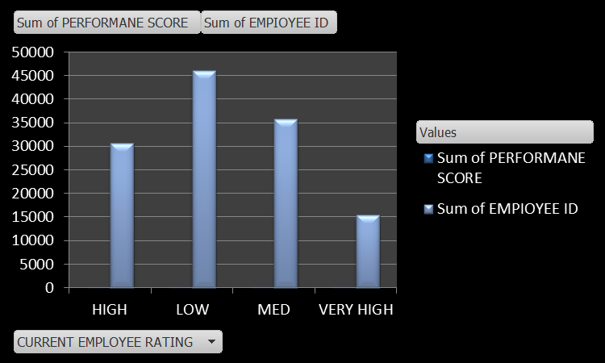
RESULTS
11

Slide 12
Conclusion
An employee database for performance analysis would involve tracking key information like employee names, roles, and departments alongside performance metrics such as productivity, task completion, and peer feedback. Performance data can be evaluated through metrics like KPIs, sales targets, and client satisfaction. Regular performance reviews and feedback loops help in identifying strengths, weaknesses, and areas for development. Analyzing this data over time allows management to identify high performers, provide targeted training, and make informed decisions on promotions or corrective actions. The conclusion drawn would guide talent management, workforce optimization, and strategic planning for organizational growth.

